Slide 1
First-Year College:
Journaling
Pat Ricé-Daniels

Slide 2

This is a brief guide/tutorial about journaling for first-year college (FYC) students.
Welcome, Bienvenidos, Shalom

Slide 3
Journaling
Journaling is a rewarding activity for most age groups including freshmen students.
Writing about the happenings of your daily life can aid in expressing or venting your feelings and thoughts.
More important, journaling is a form of therapy.

Slide 4
Journaling
As a FYC student, journaling also gives you an opportunity to write about memorable moments and notable experiences.
This writing activity can help keep you centered amidst your life changes, transitions, and new adjustments.

Slide 5
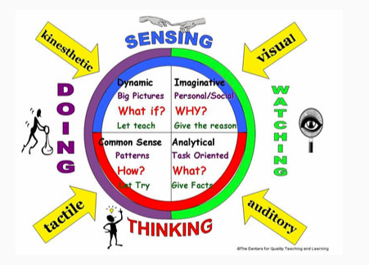
Begin Journaling
To help you get started with creating a journal, if you have taken any learning styles assessments, you can write about your assessment results.
Or, perhaps take a learning styles or multiple intelligence assessment to write about your results.

Slide 6

Journaling Suggestions
Consider writing about the following questions:
Do you think your assessment results were accurate?
What are your strong areas? What are your strengths?
Do you have any least/less strong areas?
How will you use your strong areas for writing assignments?
How can you improve your least/less strong areas?

Slide 7
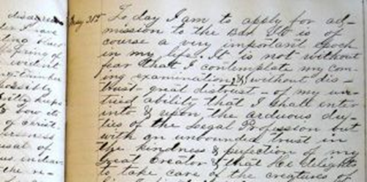
Personal freedom with your journaling
Of course, you have the freedom to write about whatever you like in your journal such as your aspirations, family and friends, off-campus activities, work/your job, campus life, your college courses, and even your instructors.

Slide 8


Journaling Tools
Your journaling tools can be pen and paper -

Slide 9
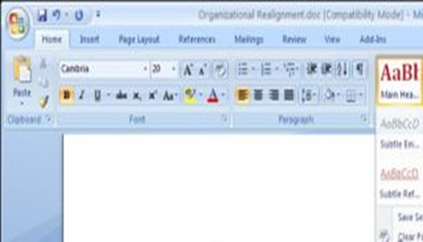
Journaling Tools
Use your software for journaling; for instance, Microsoft Word –

Slide 10
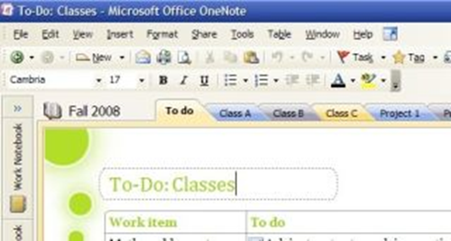
Journaling Tools
Or Microsoft OneNote

Slide 11
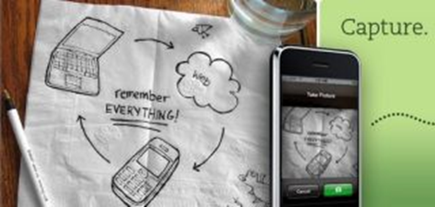
Journaling Tools
The Evernote app

Slide 12
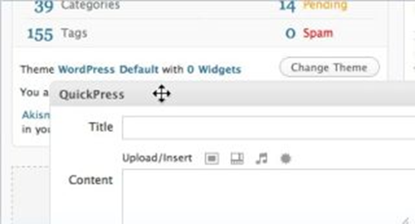
Journaling Tools
Or WordPress for Windows or Macs

Slide 13

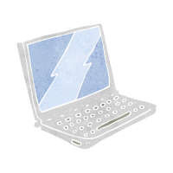
Use whatever is accommodating, convenient, and comfortable for you to do your journaling.
Remember, maintaining a journal will facilitate your writing skills, and it is a good form of personal therapy...

Slide 14
For More Information / Thank you
Journaling templates are available at various websites
And for more information or details about the aforementioned journaling software or applications, visit: http://lifehacker.com/5246819/five-best-journaling-tools
Thank you for listening and watching - and happy journaling

