Slide 1
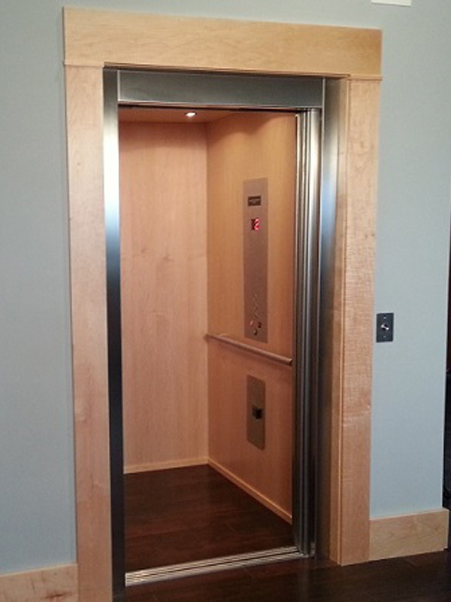


My Elevator Pitch
Notes:
Hi, I’m Pat Ricé – and it’s nice to meet you; I am quite familiar with your educational institution and its innovative instruction program. I have a master’s in education and another in English comp, plus, I’m certified to teach English-as-a-second-language. I graduate Fall 2023, I am completing my 3rd master’s in the library information science program at San Jose State, and I have completed my internship at the Pfau Library located at Cal State Univ. San Bernardino. I have gained valuable information literacy experience thru this internship -- which is why I would really like to work at your institution. Perhaps you can tell me who to contact, so I can reach out to you as soon as possible -- thank you for your time.

