Slide 1



Discover Your Talents to Develop Your Writing
Pat Ricé-Daniels

Slide 2
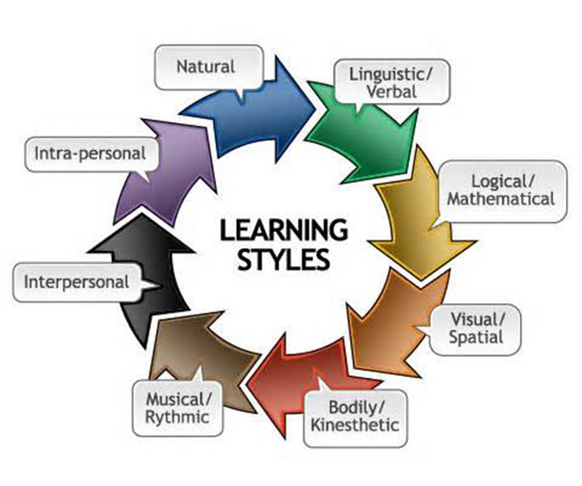
Learning Styles Modalities for First Year Writing Students – (Tutorial)

Slide 3





Instructions: Read each statement carefully. Choose one of the five buttons for each statement indicating how well that statement describes you.
1 = Statement does not describe you at all
2 = Statement describes you very little
3 = Statement describes you somewhat
4 = Statement describes you pretty well
5 = Statement describes you exactly

Slide 4


Find my strengths!
(Examples of results)
Musical: You like the rhythm and sound of language. You like poems, songs, and jingles. You enjoy humming or singing along with music. You probably remember things well when they are associated with music or rhythm. Try to incorporate sounds into your lessons, such as using a familiar tune, song, or rap beat to teach spelling rules, or to remember words in a series for a test.
Self: You have a very good sense of self. You like to spend time by yourself and think things over. You will often take in information from another person, mull it over by yourself, and come back to that person later to discuss it. You like working on projects on your own. You often prefer to learn by trial and error. Effective techniques to enhance your learning include keeping a journal and giving yourself time to reflect on new ideas and information.

Slide 5

SAVE YOUR RESULTS
Be sure to save your results to review or reference later, to share with your instructor, and, more important, to facilitate your writing activities.
Click on the link below (or copy/paste in browser) when you are ready to get started
http://literacynet.org/mi/assessment/findyourstrengths.html

Slide 6
Thank you for listening and watching this tutorial as part of your first writing course.
This Multiple Intelligences for Adult Literacy and Education assessment is part of the Multiple Intelligences Survey (MIS) - based on Howard Gardner’s Multiple Intelligence Theory.

